Slide 1
Token Authentication

Slide 2
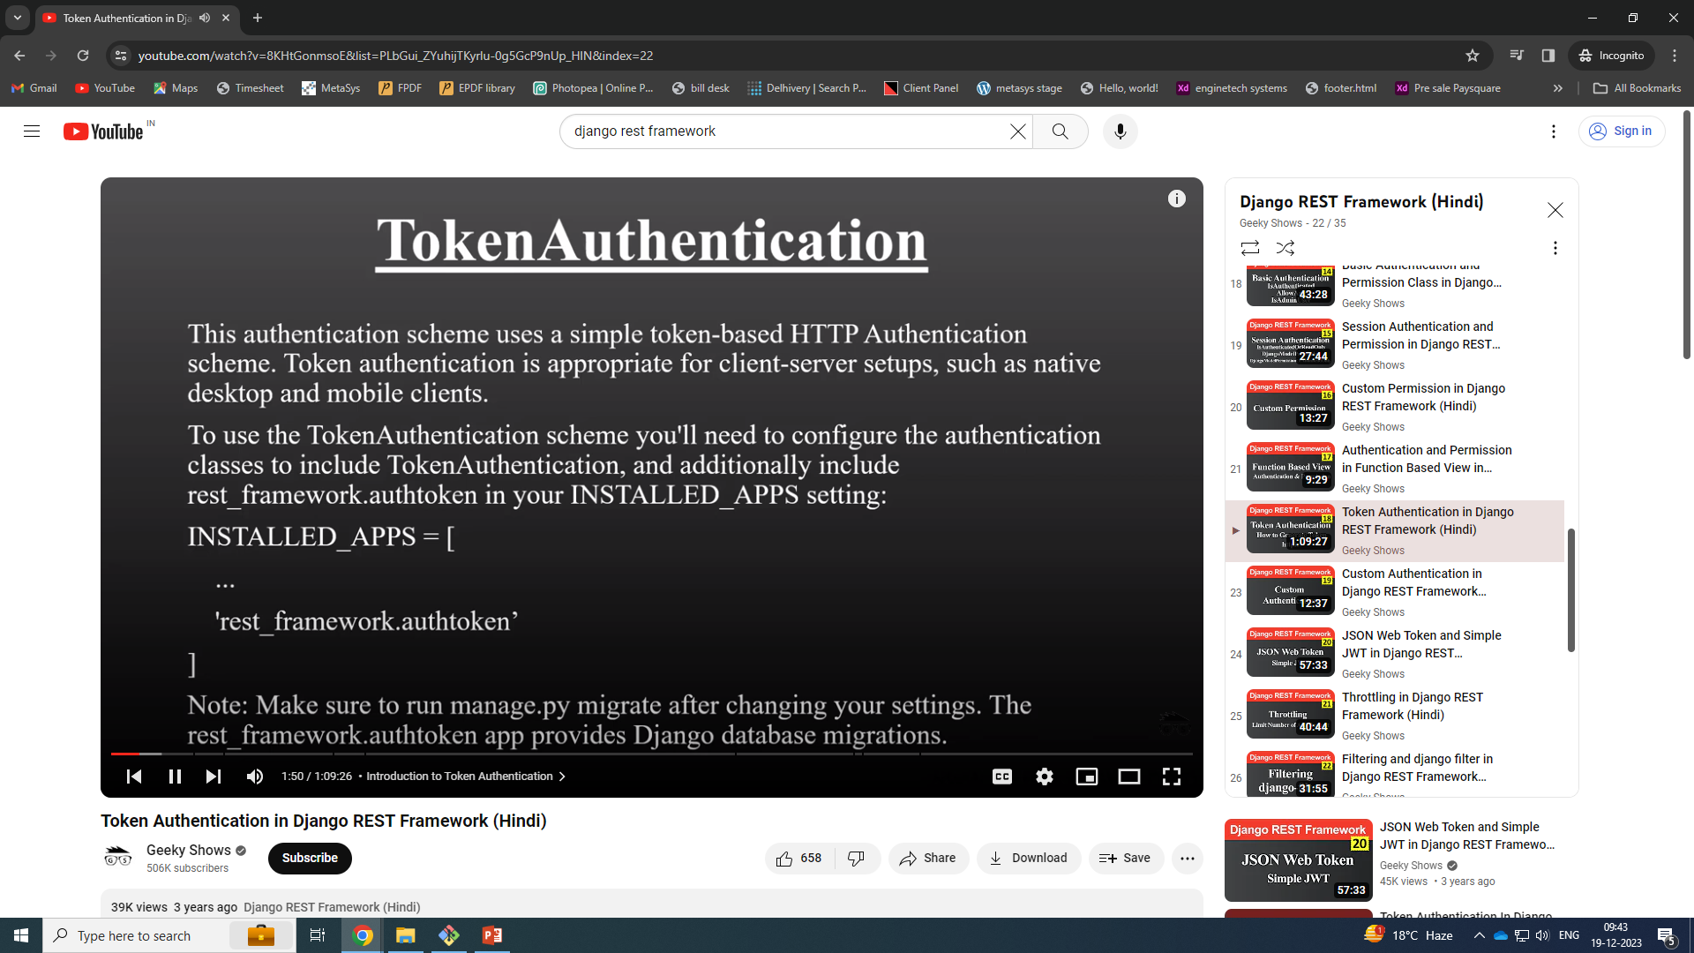

Slide 3
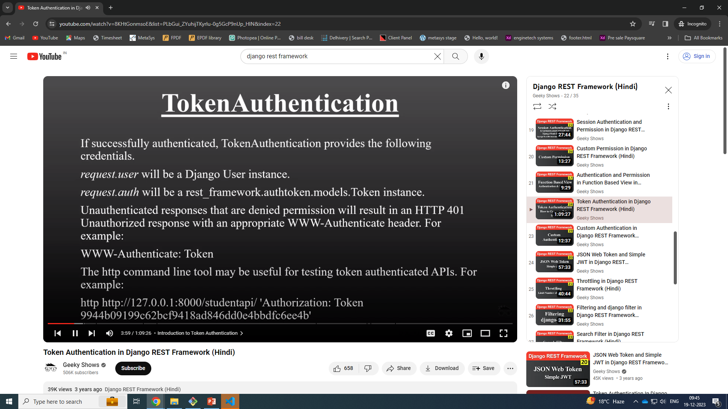

Slide 4
User https method
Use token if you have token

Slide 5
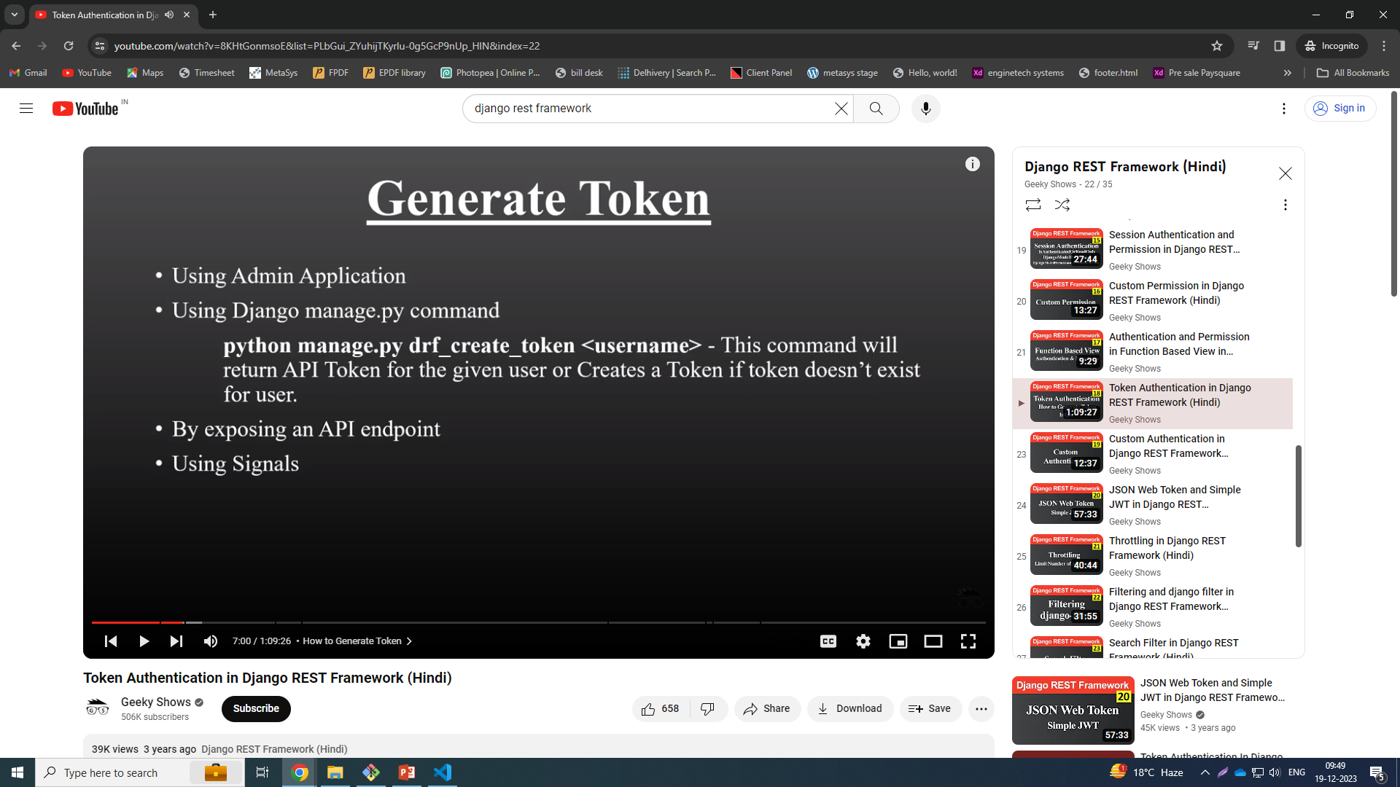

Slide 6
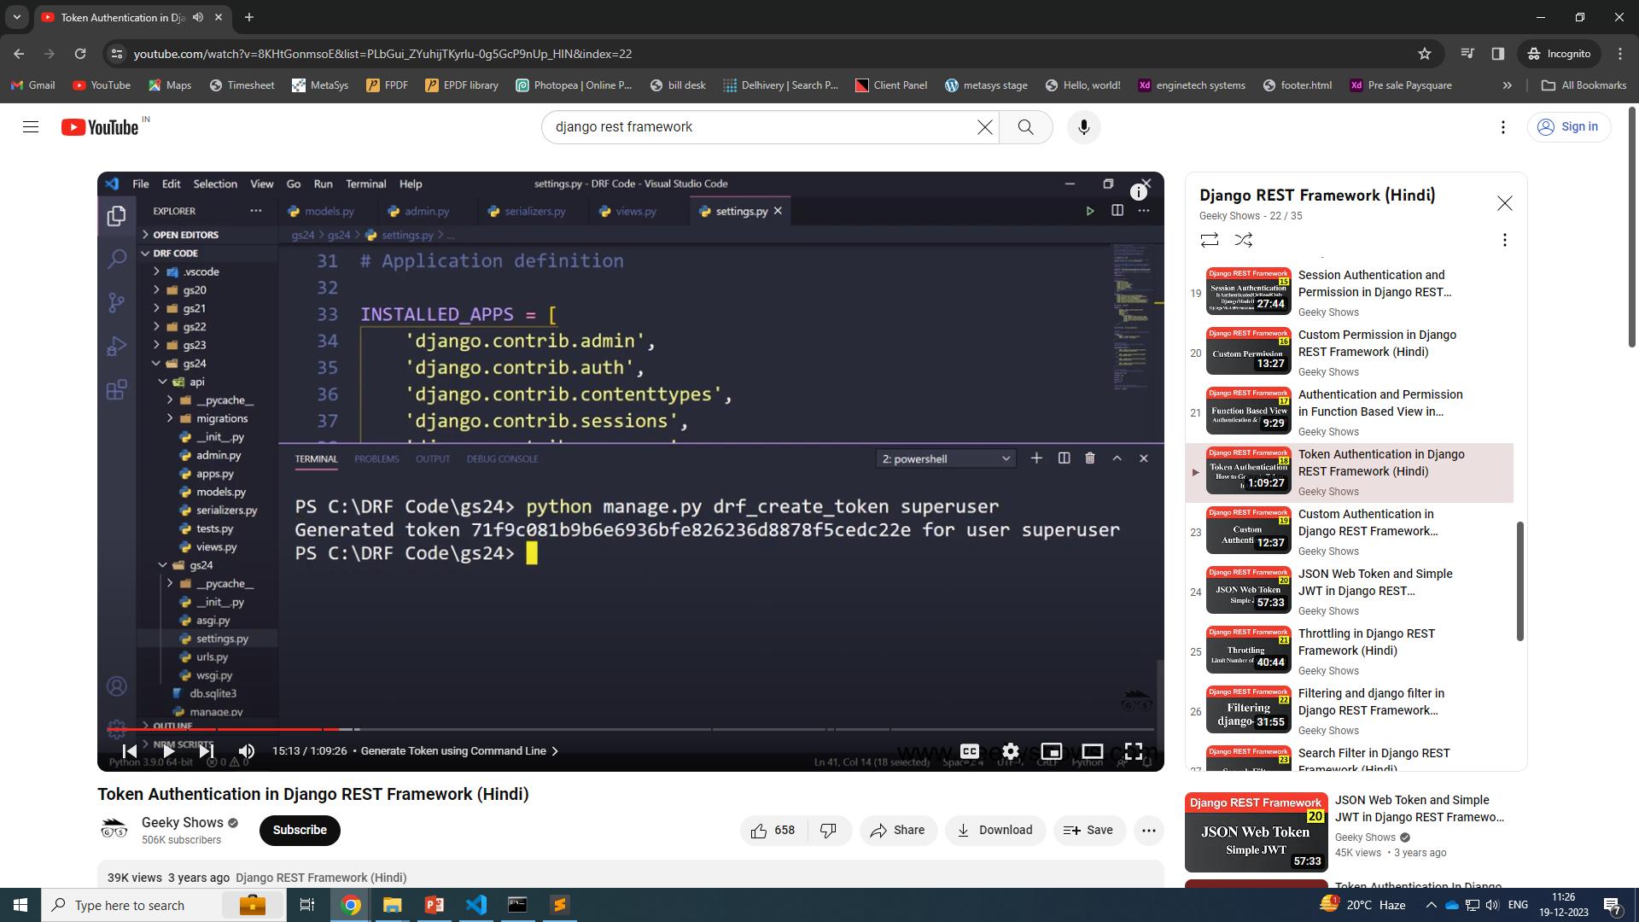
python manage.py drf_create_token user1

Slide 7
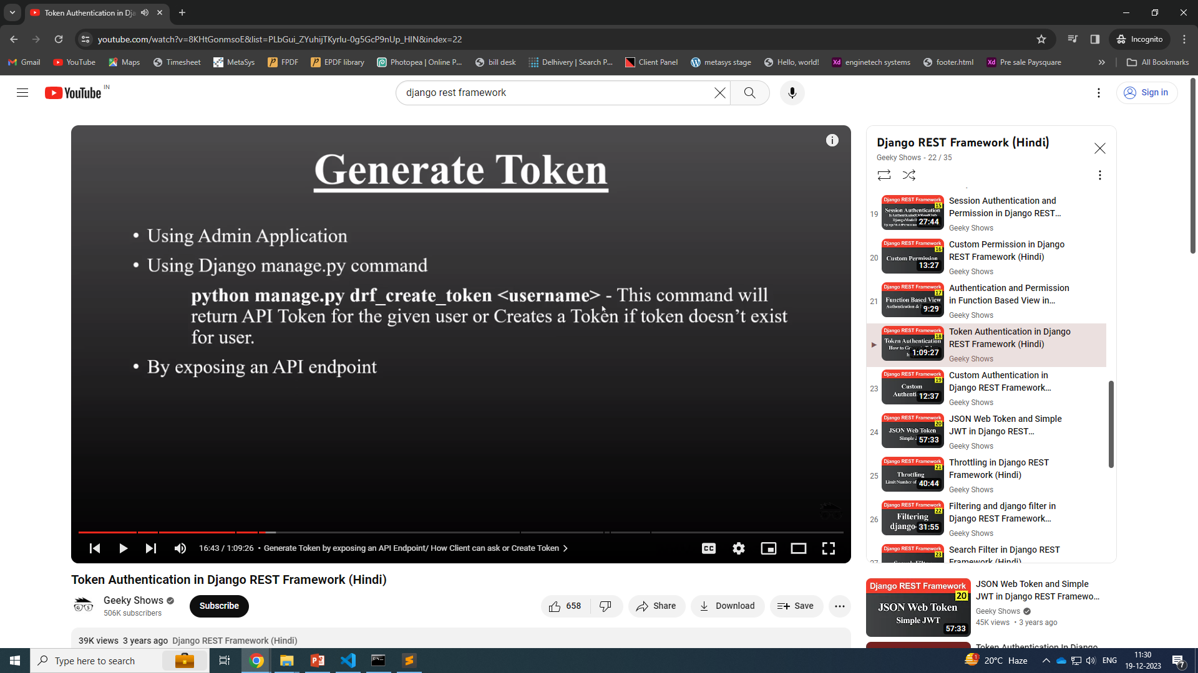

Slide 8
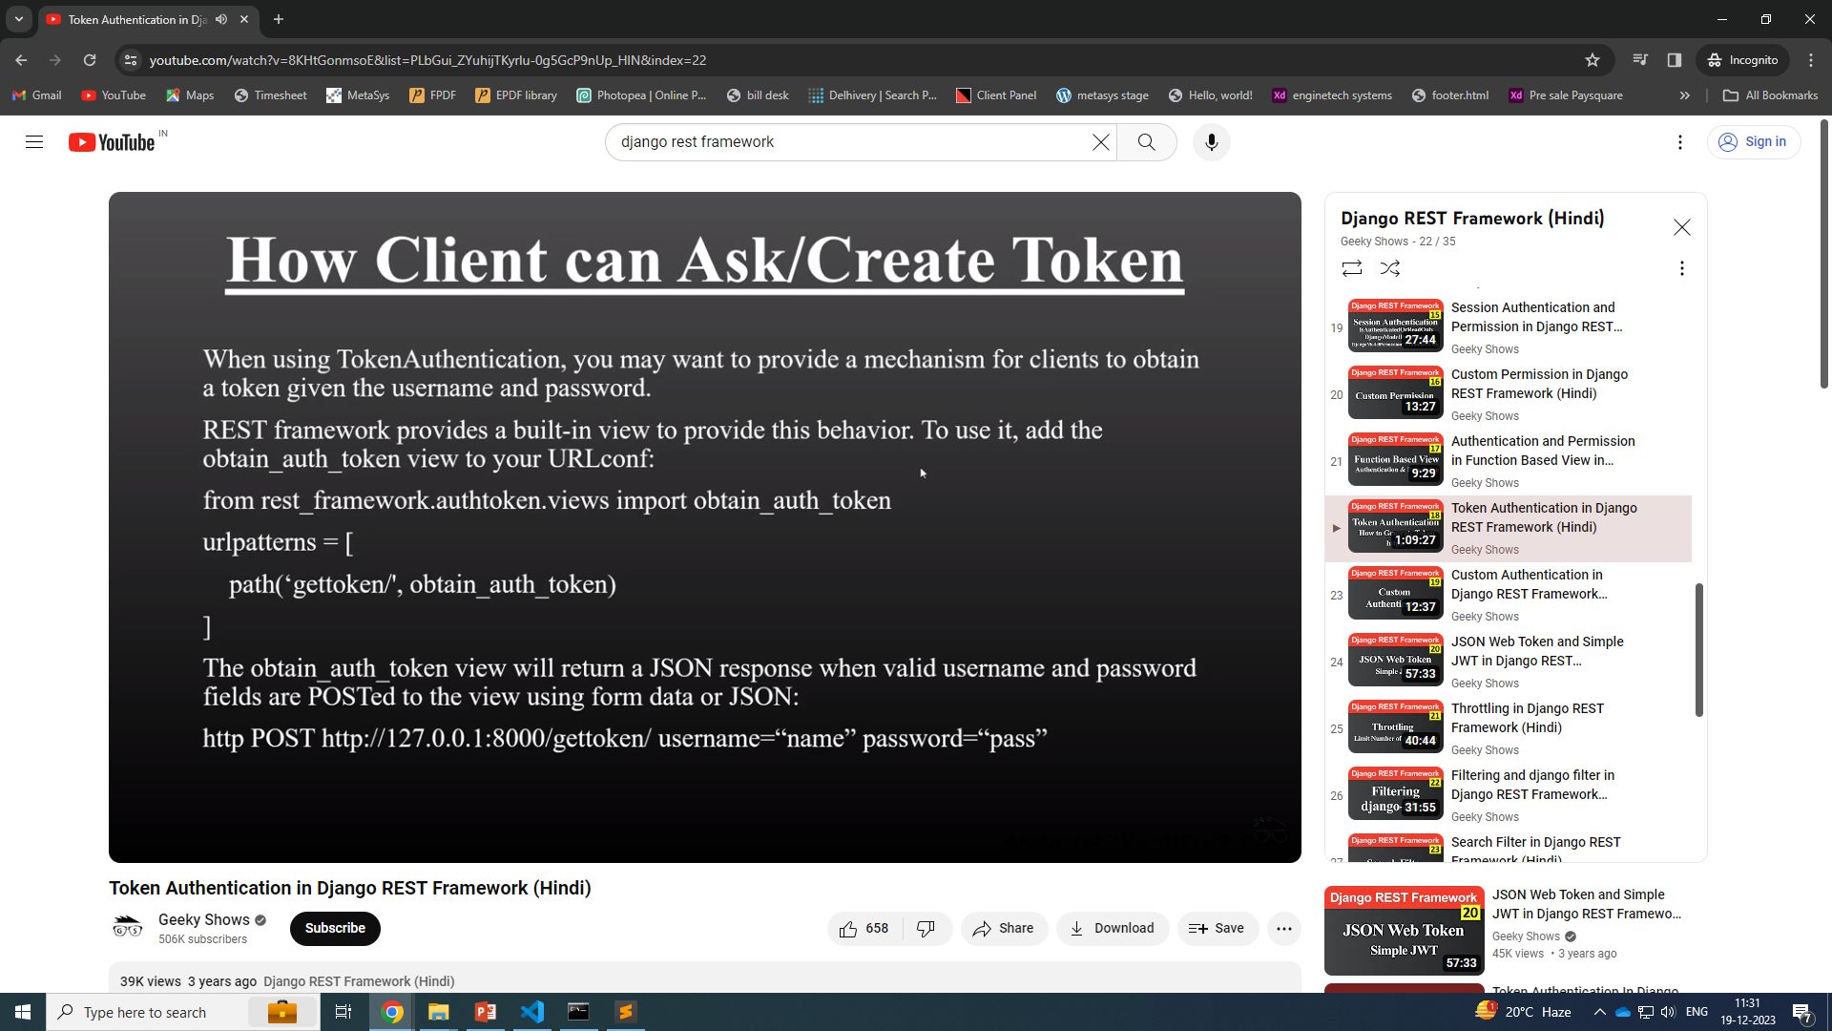

Slide 9
Httpie
pip install httpie

Slide 10
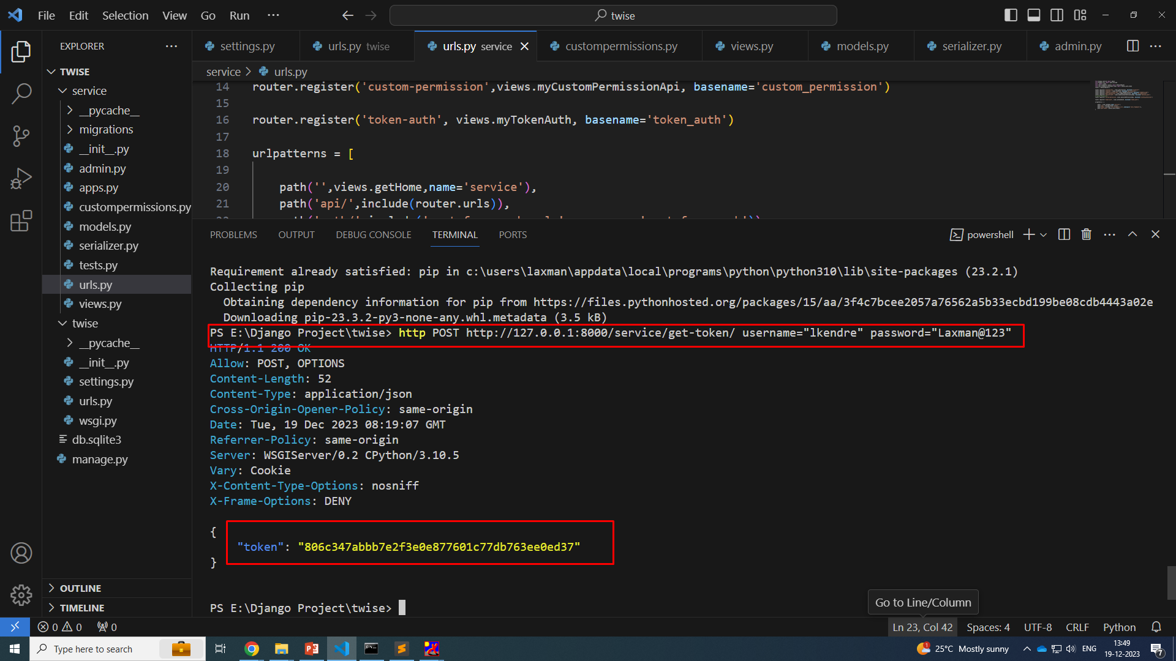
POST http pie request

Slide 11
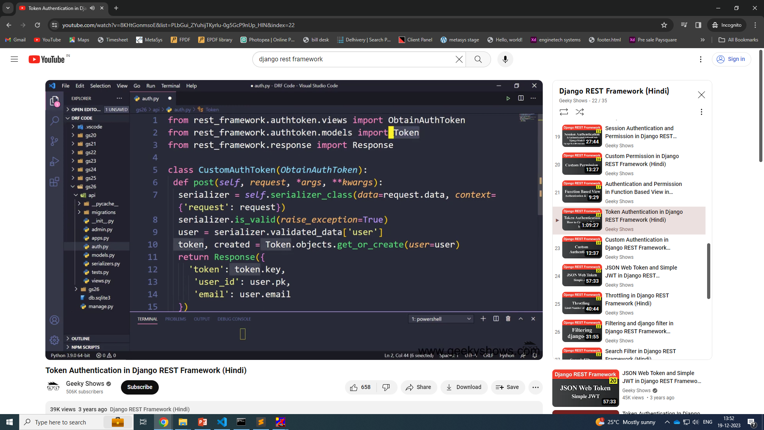

Slide 12
Custome Token Generate auth.py
from django.http import JsonResponse
from rest_framework.authtoken.views import ObtainAuthToken
from rest_framework.authtoken.models import Token
from rest_framework.response import Response
from rest_framework import status
class CustomToken(ObtainAuthToken):
def post(self, request, *args, **kwargs):
serializer = self.serializer_class(data=request.data, context={'request': request})
serializer.is_valid(raise_exception=True)
user = serializer.validated_data['user']
token, created = Token.objects.get_or_create(user=user)
return JsonResponse({
'token': token.key,
'user': user.pk,
'email': user.email,
}, status=status.HTTP_200_OK)

Slide 13
Urls.py
path('get-token/',CustomToken.as_view() ),

